Slide 1
South Atlantic Umpires 2025
Two Person Umpire System
Frank Sardoni 8/26/2025

Slide 2
Key Points
2 person Umpire System
Please understand the point of these mechanics are to create a fundamental understanding of the 2 umpire system
This presentation is a basic way to run 2 man. Understand that different assigners, organizations and crews may run the system differently. It does not mean it is wrong!
Verbal and visual communications is key!!!
Keep it simple: 3 rotations
Be a crew guy: Know both your and your partners responsibilities

Slide 3
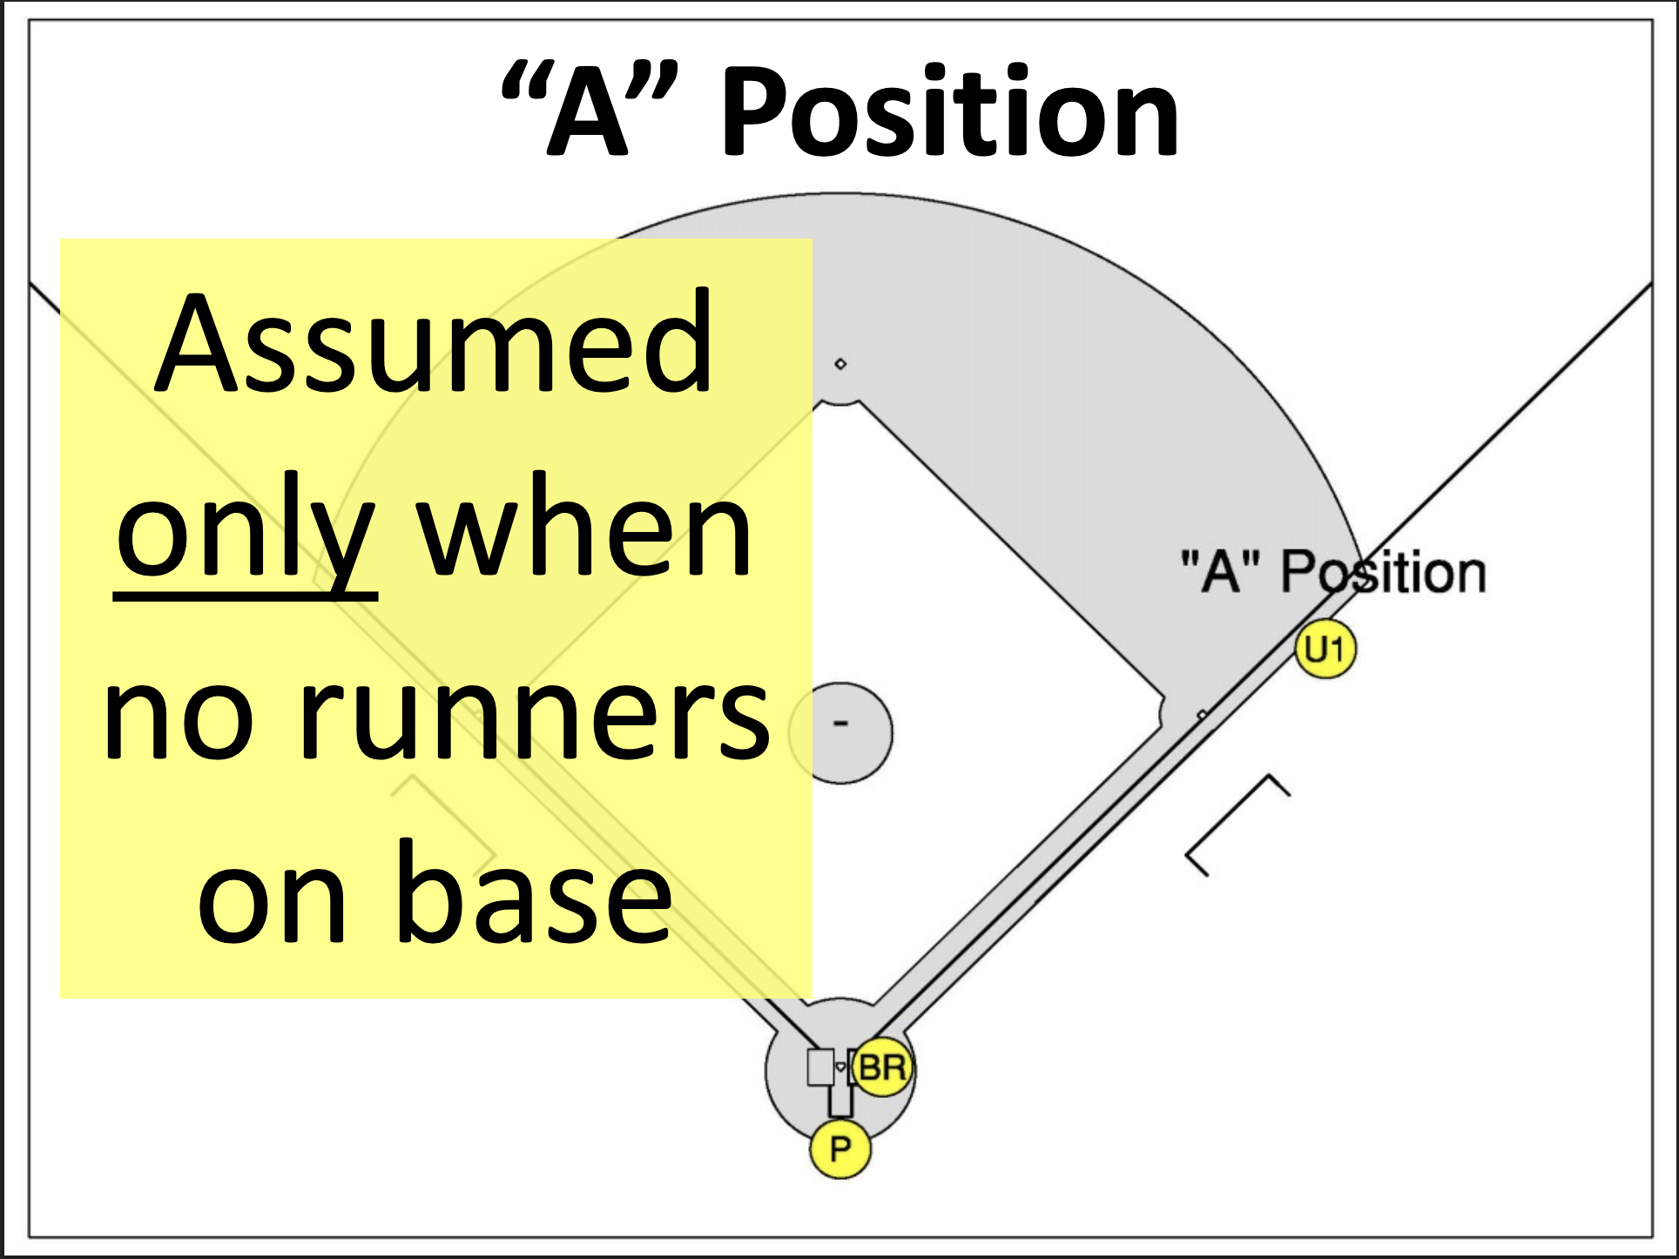
Positioning

Slide 4
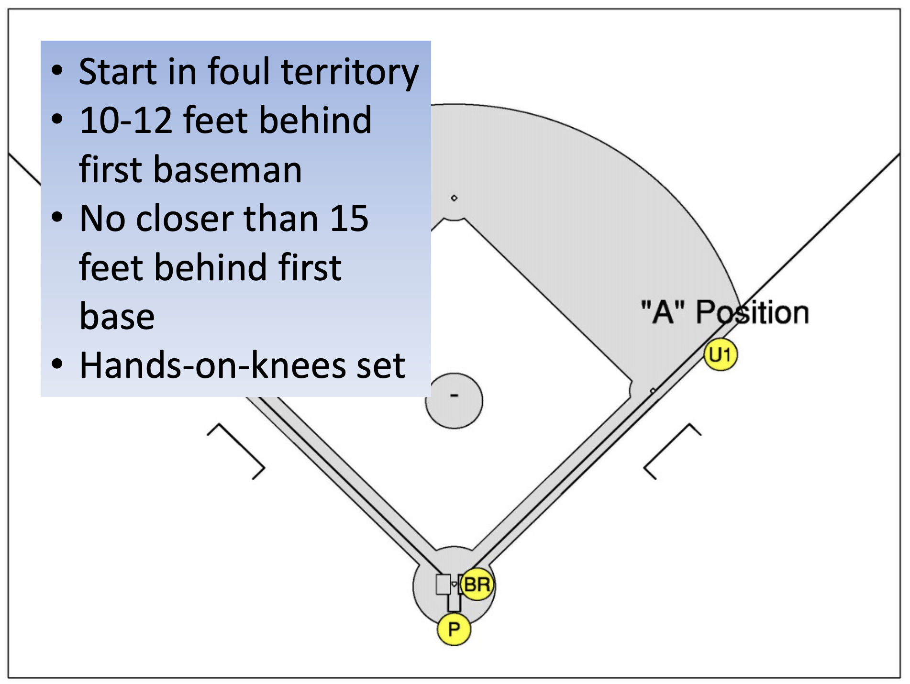
Positioning

Slide 5
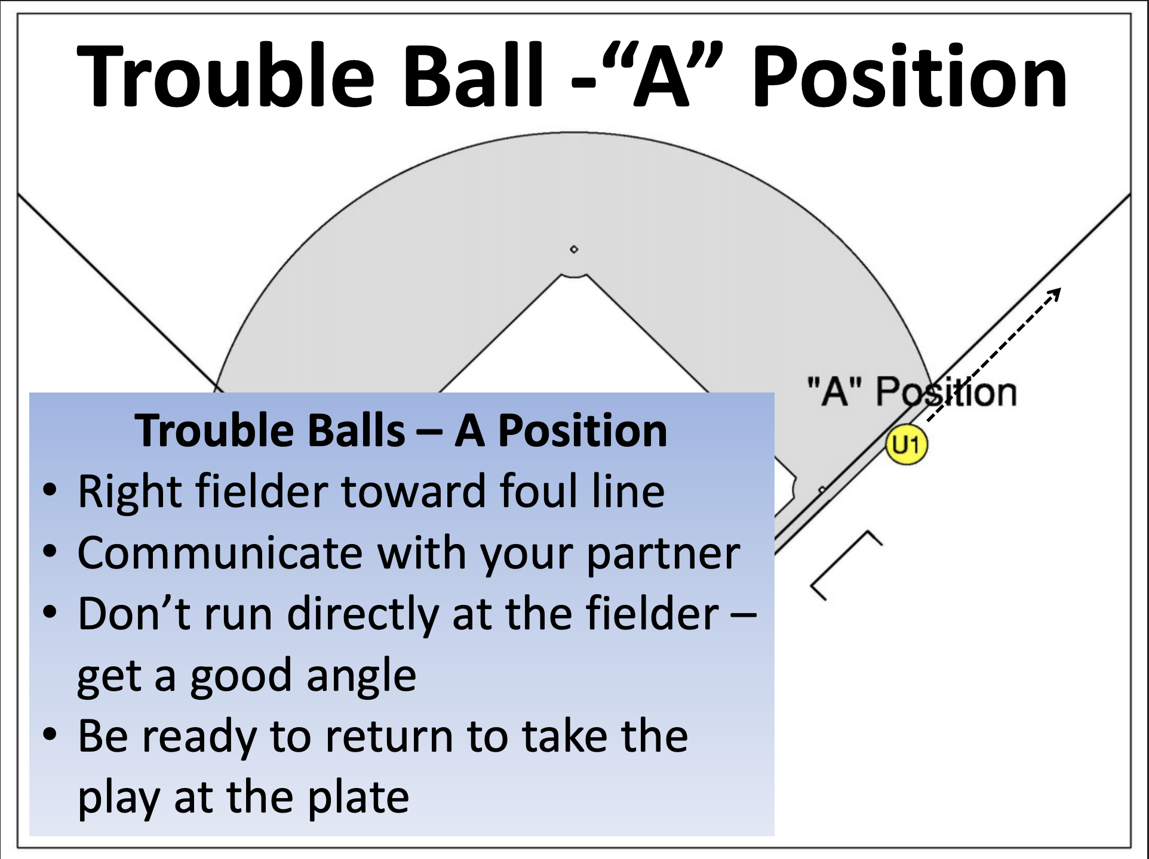
When to “go out” from A

Slide 6
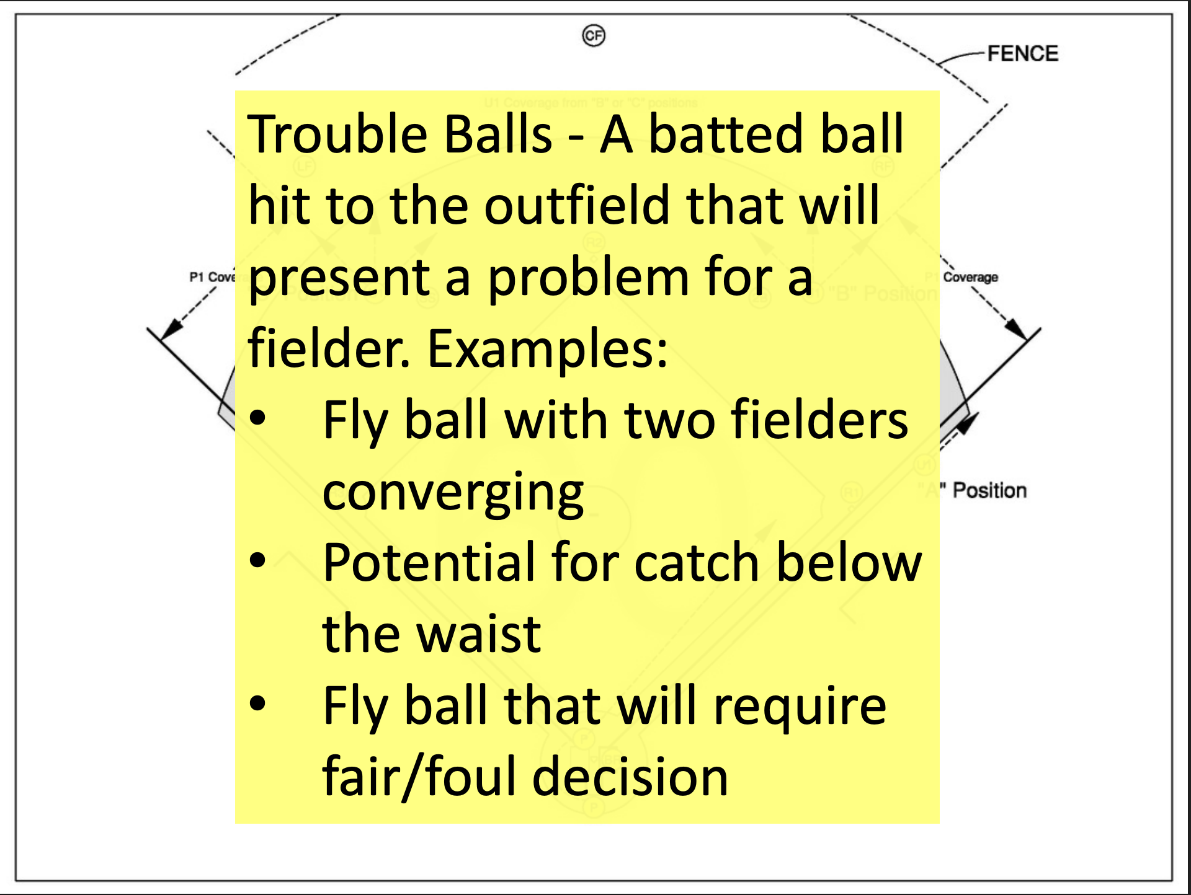
When to “go out” from A

Slide 7
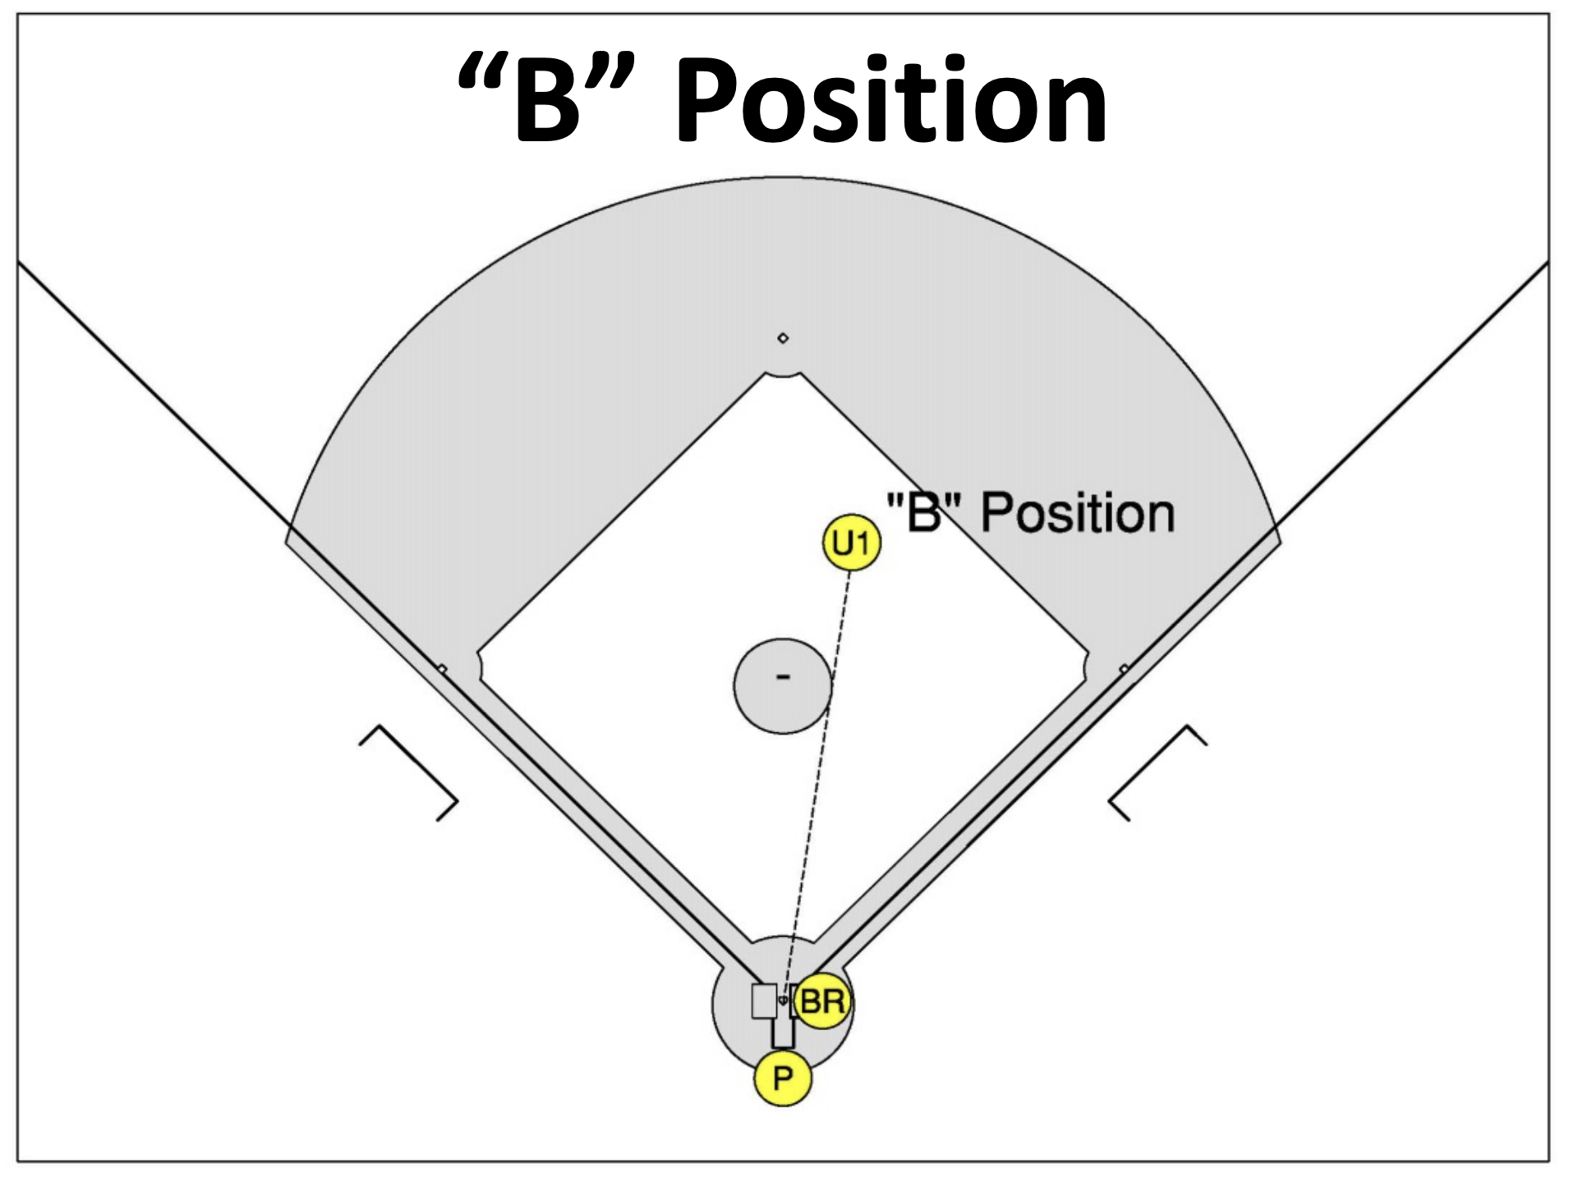
Positioning
Assumed when
Runner at 1B
Runners at 1B & 3B

Slide 8
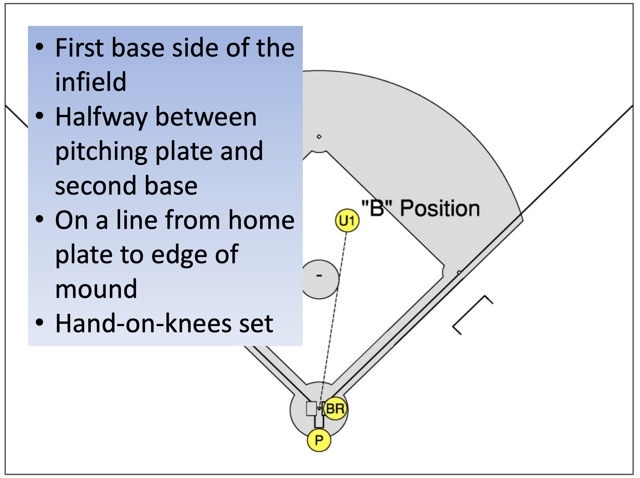
Positioning
Assumed when there is a runner at first base

Slide 9
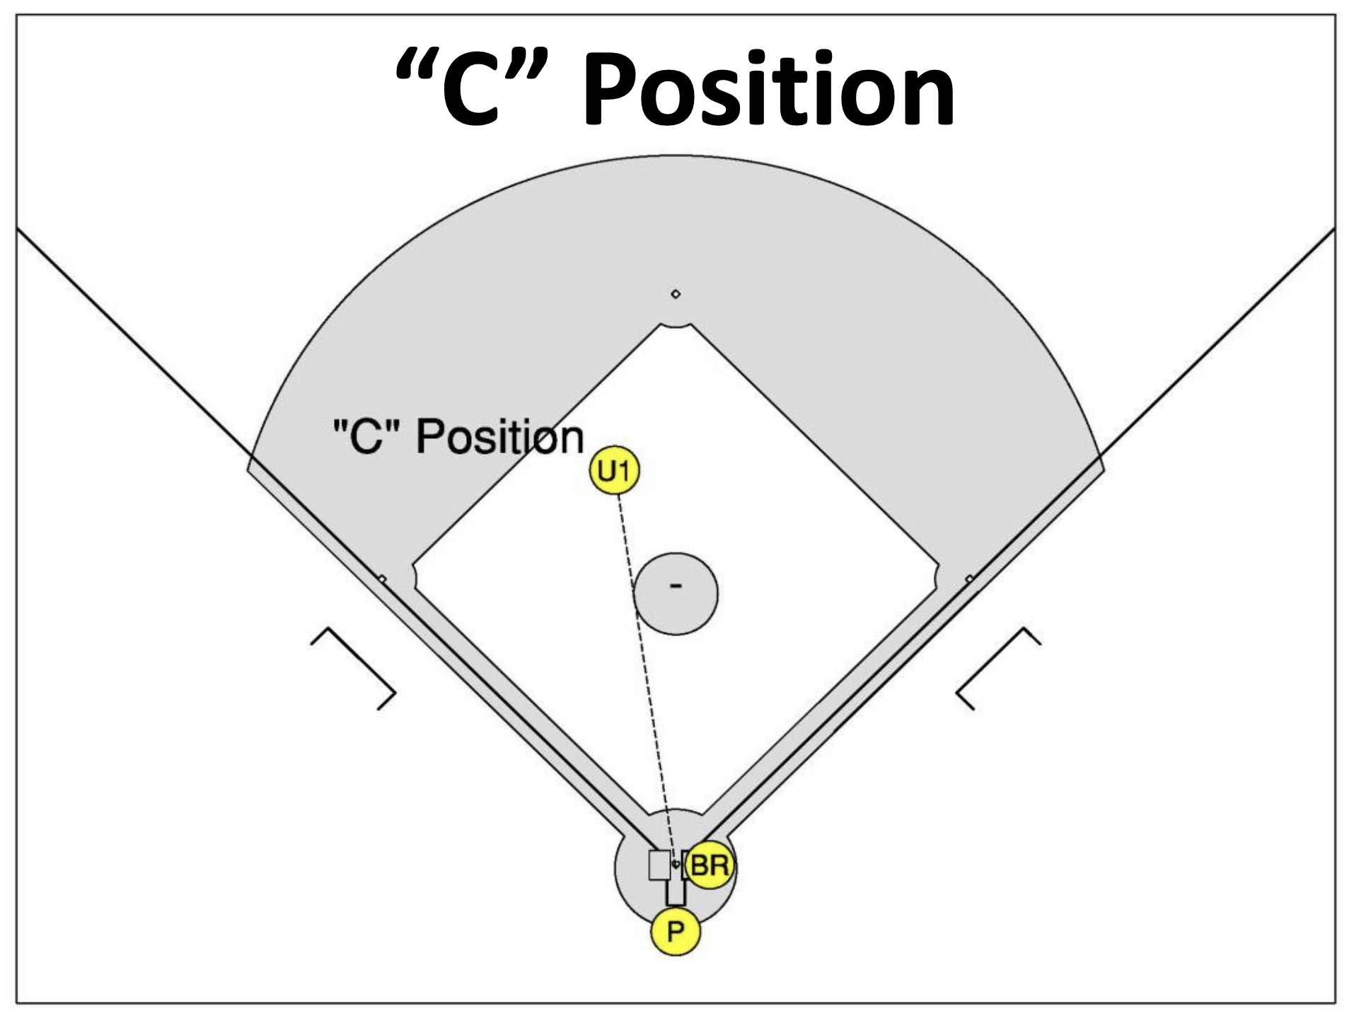
Positioning
Assumed when:
Runner at 2B
Runners at 1B & 2B
Runners at 2B and 3B
Bases Loaded
3B only

Slide 10
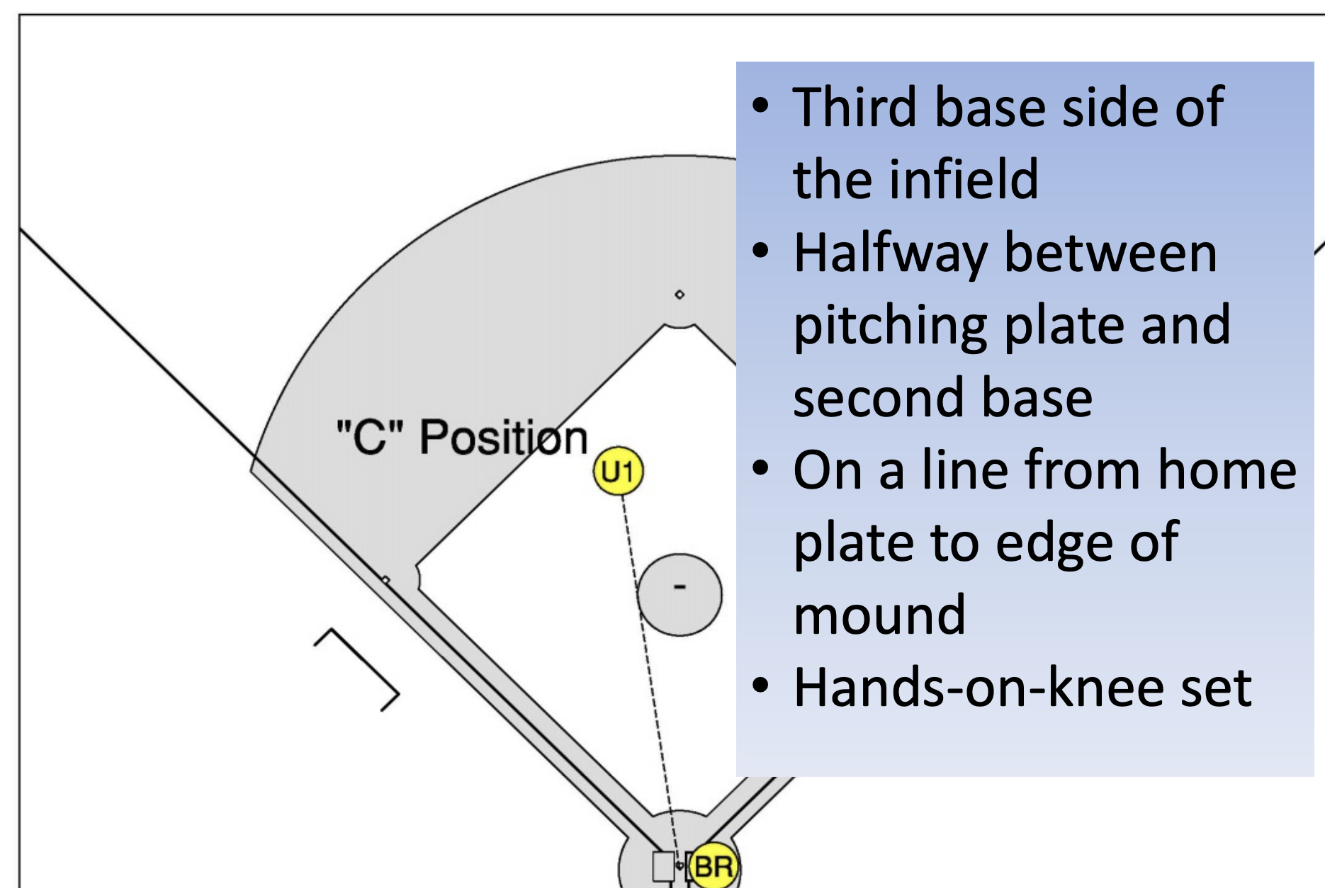
Positioning
Assumed when:
Runner at 2B
Runners at 1B & 2B
Runners at 2B and 3B
Bases Loaded
3B only

Slide 11
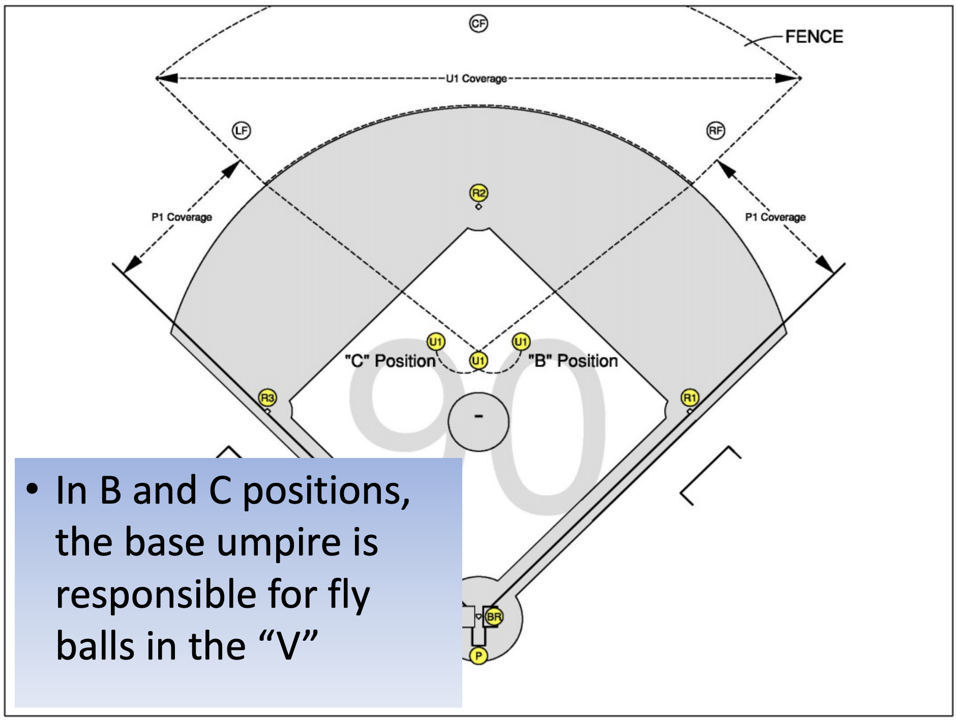
Fly ball coverage

Slide 12
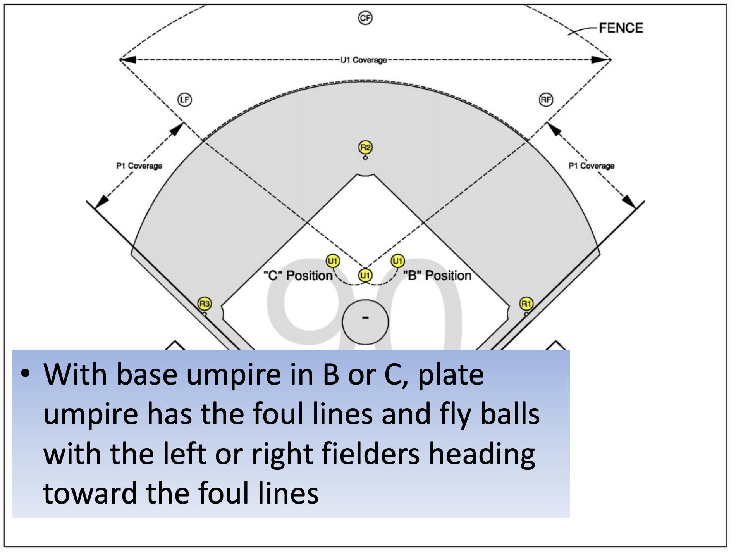
Fly ball coverage

Slide 13
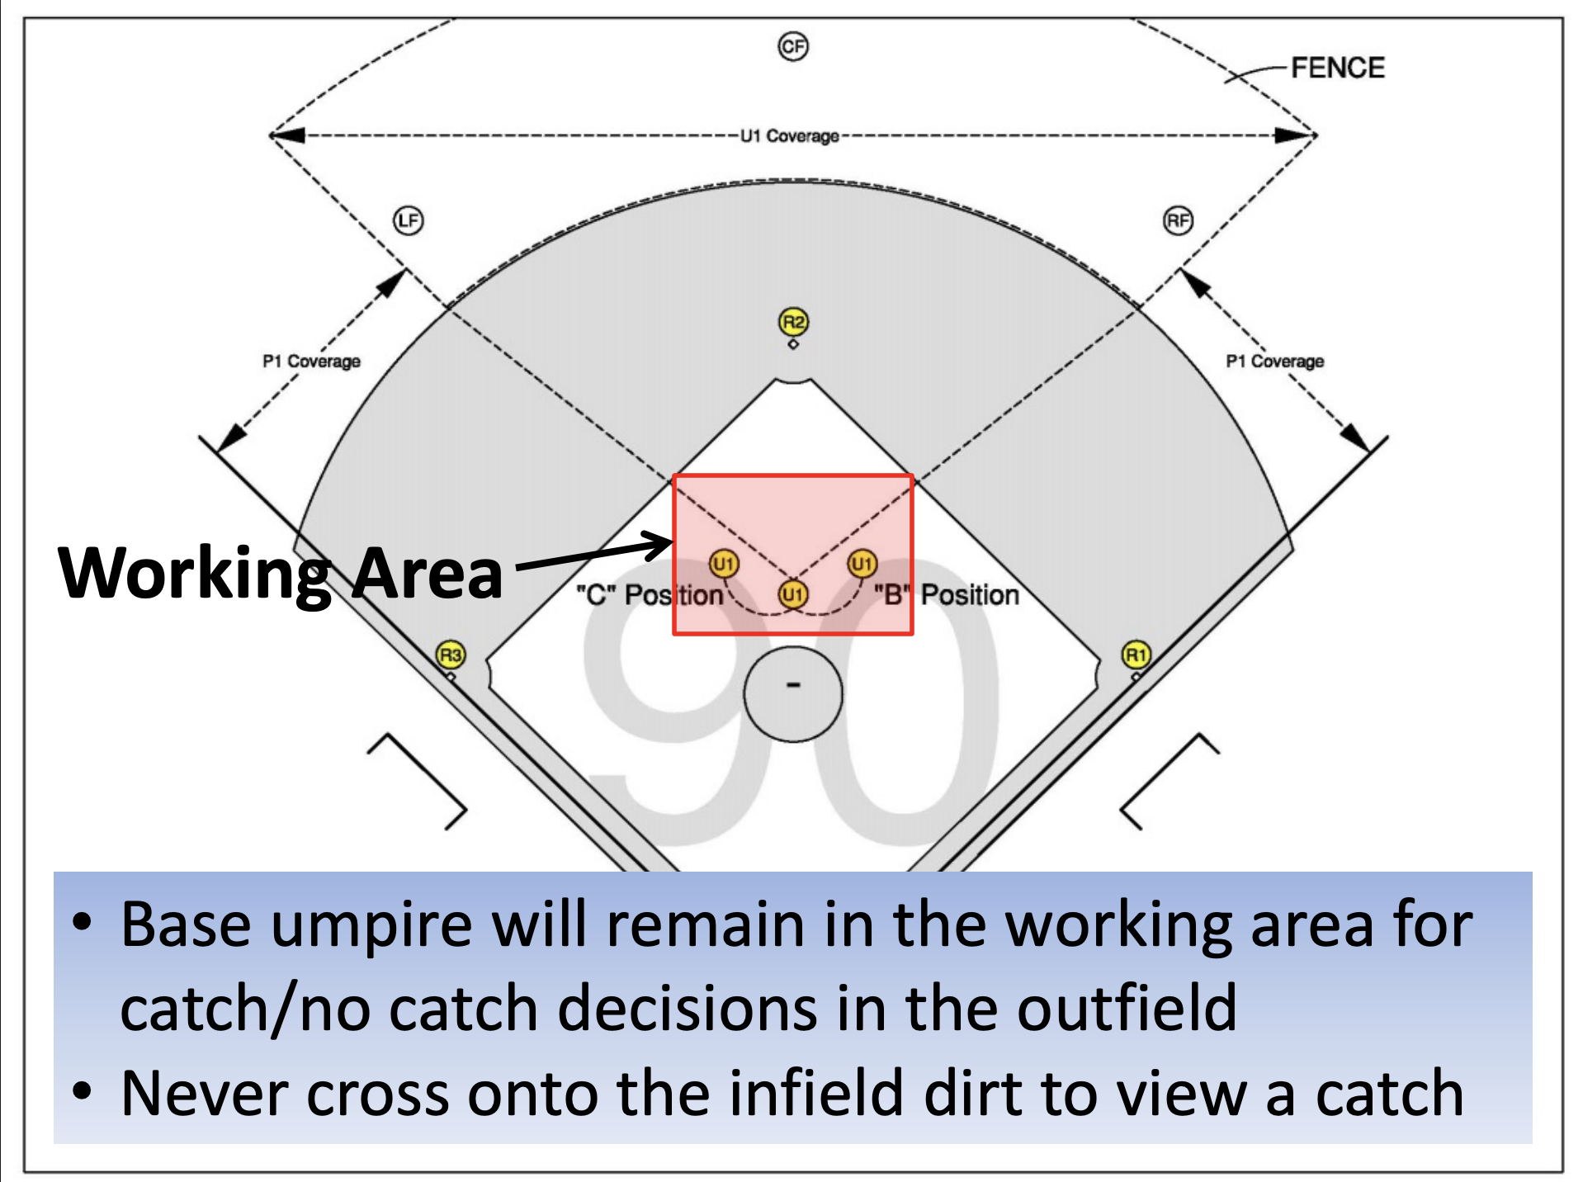
Fly ball coverage

Slide 14
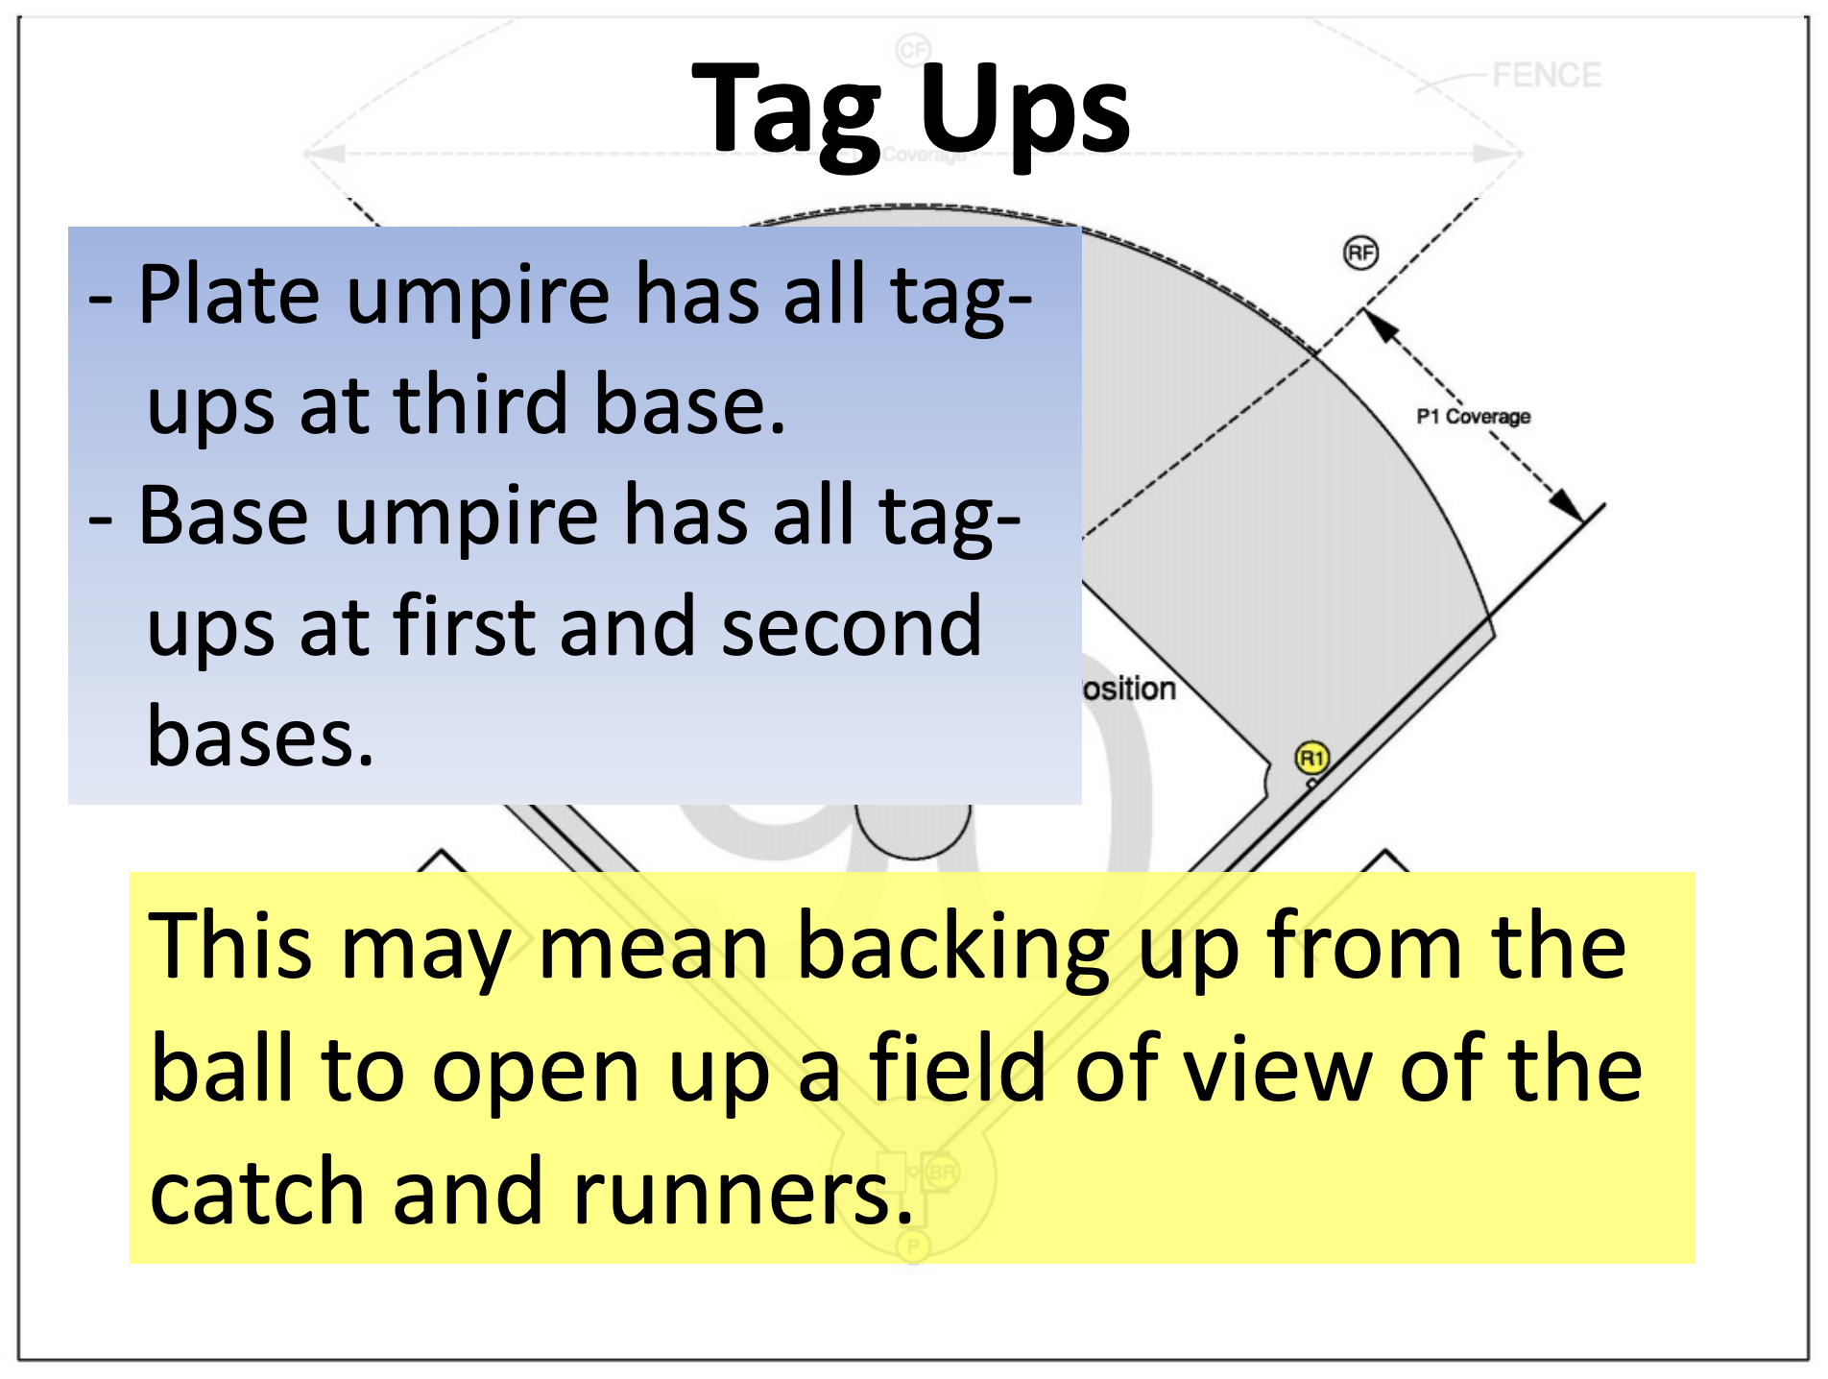

Slide 15
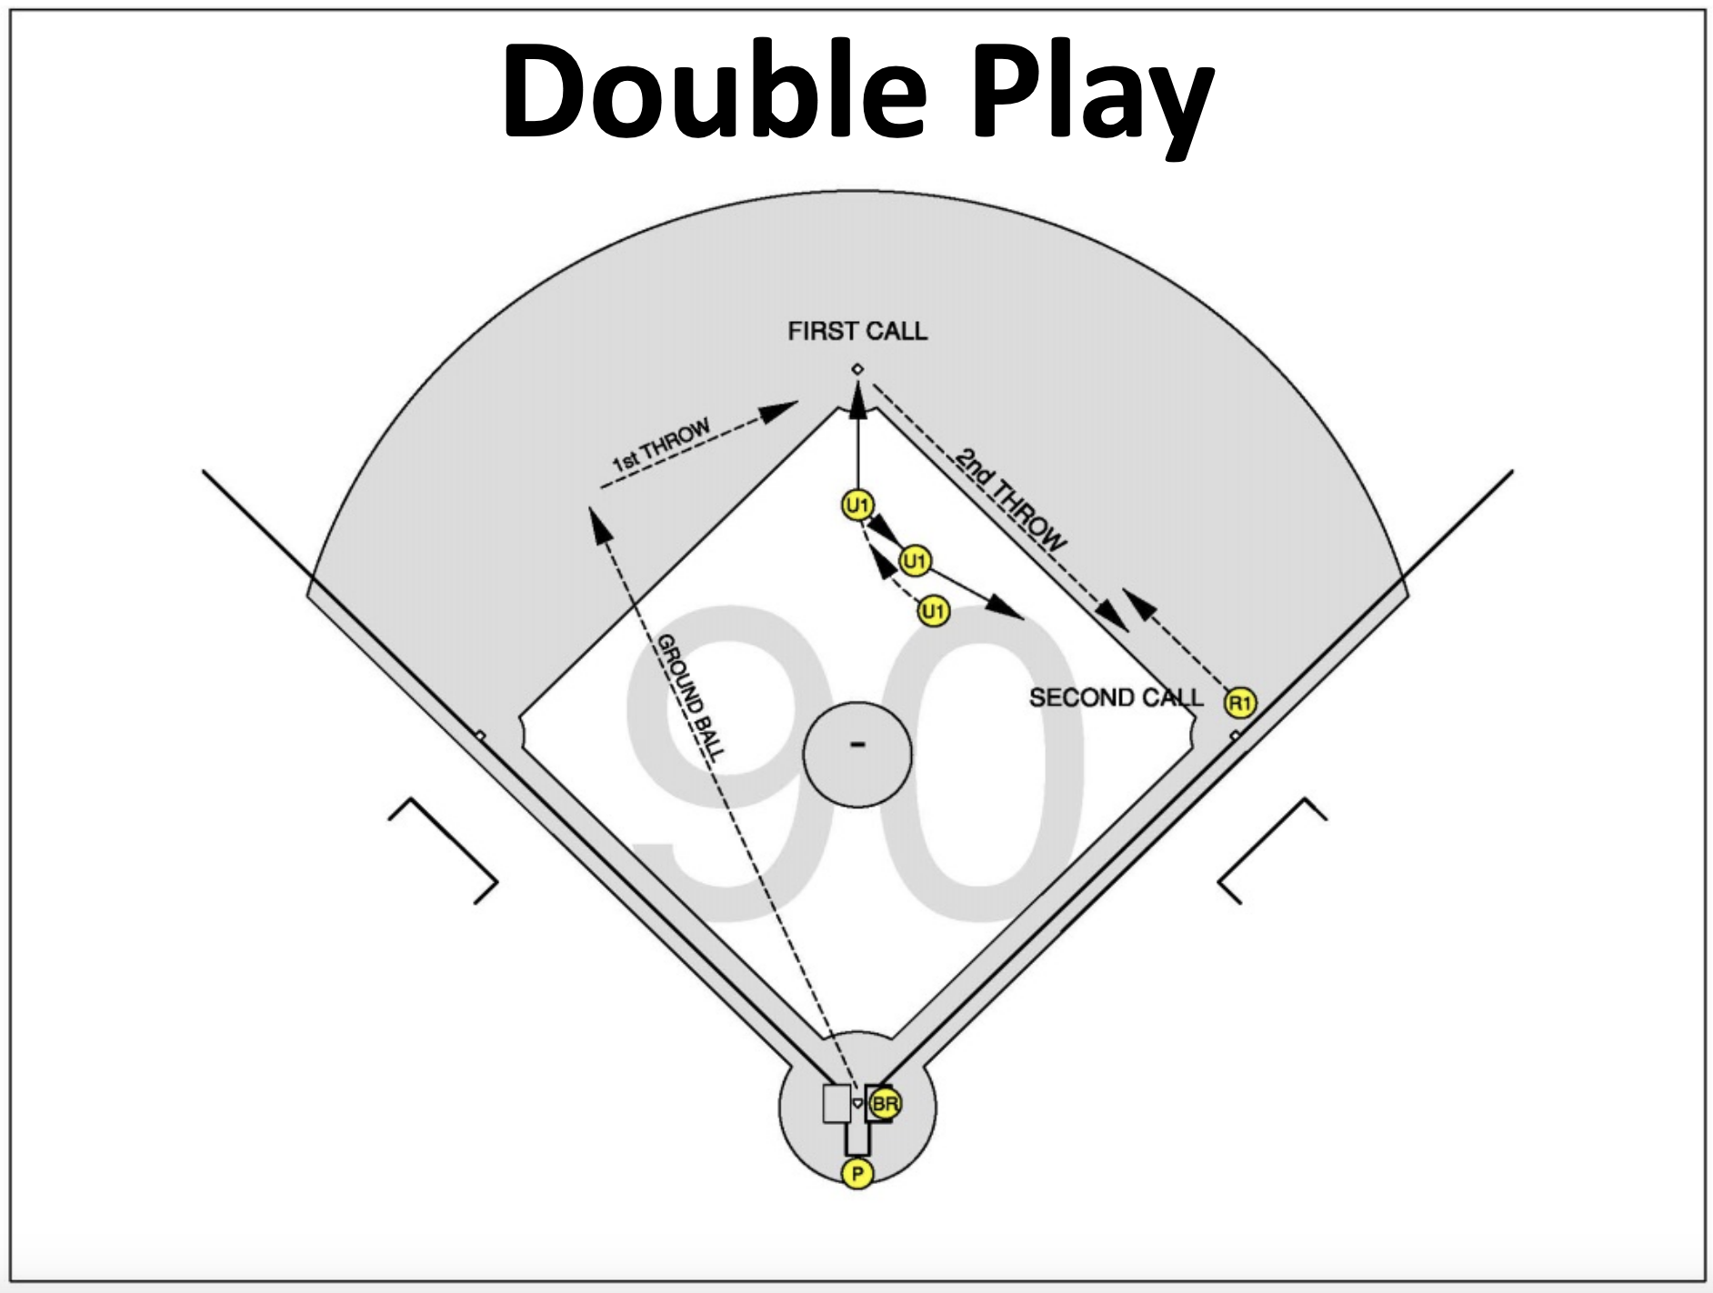

Slide 16
Rotations
Only 3 Times we rotate:
Runner on First and Clean base hit (This is a mirroring situation) PU mirrors R1
Runner on First and Third and clean base hit. (This is a mirroring situation) PU mirrors R1
Runner on First and Second, less than 2 outs, fly ball to the outfield, R2 commits to third base. No mirror PU must get a jump on the play.
If the ball is down the Right field line he should tell his partner he is on the line. This should let his partner know to cover the play into third base.

Slide 17
Game Management
Pregame with partner
Pregame with your partner See Handout.
When you are in A you have from the base back or from the cutout back
If you go out I will take all the bases. Do not come back in if u go out.
When you come in to B or C we have big V little V Big V, the lines belong to PU and left field in, to right field in belong to U1
Kill anything u see in the box if PU does not come up immediately.
Balks anyone can get.
PU will come up the line on ground balls for pulled foot or swipe tag. PU should use open hand close had to signal partner if he has or does not have a pulled foot or a tag.
Running lane violations are PU
Over throws PU has the ball U1 has batter runner.
When in A foul ball that has no chance of going fair. PU and U1 should bracket the fielder if possible which ever umpire is facing the catch should make the call. Other wise always Protect the line.
Only 1 on deck batter, keep players in the dugout on big plays do not have them gather near home plate. Interference on a thrown ball comes into play
Plate Conference with coaches should be thorough. See cheat sheet you should have in your game book that you bring to the plate conference.
Post Game with Partner: Discuss any plays that could have been done better.

Slide 18
Game Management
Plate Conference Setting Expectations
The plate conference is all about you setting expectation’s on how you will run this game. If your plate conference is short and does not go into certain areas the coaches do not know what to expect . This is your opportunity to let them know and actually pre warn them about things that are not up for discussion.
We will go into that below.
Take Lineup card from home coach first , check for any errors or duplicate names, once you have both lineups have the home coach go over ground rules.
Address head coaches by name write them down if it is not on the lineup card. Make sure that he is head coach.
Ask about game management, trainer, is everyone legally equipped. Mark lineup card appropriately.
Discuss any run rule , 15 after 3 10 after 5
Courtesy runner for Pitcher and Catcher cannot be the same runner. Must be a player not ever in the line up when they run.
Go over Force play slide ,
Judgement calls, balls, strikes, check swings hit by pitch. Not to be discussed. This is a pre-warning so if a coach starts to chirp you have already told him in the PC that U will not tolerate this. Now if you warn him he has really gotten 2 warnings. This is on him moving forward.
Plays at the plate. Related to obstruction interference malicious contact, nothing are judgement calls.
P/DH no courtesy for pitcher or catcher if applicable.
If there is a question about a rule interpretation or a pulled foot bobbled ball please come out to the 45 and ask the umpire whose call it is. Tell coaches if we get together you must go back to coaches box or dugout, once we make a ruling it is final. We only communicate with the head coach. Do not ask for help on a judgement call that is totally yours. Example , steal of third when u are in C , coach asks for you to go the PU for help. Do not entertain that unless you fell down or went blind. It is your judgement.
Only 1 on deck batter, keep players in the dugout. Tell them not to pour out on the field on a big hit. Interference may come into play on thrown ball to the plate be preemptive.

Slide 19
Game Management
Game Situations
Close play where coach comes out. Know what point it is in the game.
Be empathetic, allow some leeway but there comes a time when you have to get the game moving make sure he is asking a question, coach we have to agree to disagree lets go we need to get the game moving.
Assistant coaches should be seen but not heard.
Do not take stories other umpires have told you into your game when it pertains to a Coach or Team. It is nice to know but should not have you on edge, nothing may happen.
Balls and strikes issues.
  Acknowledge ( Glance over at the coach or I heard you coach, Warn, restrict, eject. If you did a good plate conference they were already warned. We already discussed this (Coaches name) if this continues you will be warned then restricted, this is on you, or I am trying to keep you in this game (if it continues.)

Slide 20
Plays at the plate.
Understanding the wedge
Remain at the point of the plate
Read the throw, stay on the catchers plate side hip.
6 to 8 feet from the play.
Move with the play and the catcher, movement can pull you into fair territory
Try to keep 90 Degrees for best view. There are always 2 wedges.
Do not rush your call, make sure the catcher has the ball.
https://www.youtube.com/watch?v=WWA-Vzn_BPE. 4:47 Mark
https://www.youtube.com/watch?v=fEFhGpCdvMg. This a great video for explaining the wedge
https://www.youtube.com/watch?v=Kpppt99WSZo. This video has some examples of bad positioning,.
https://www.youtube.com/watch?v=-q6ZExGHE3k. 7:10 mark Not Obstruction

Slide 21
Run Downs
2 Instances we Bracket the runner.
Between First and Second Plate Umpire should come up on a pick off and tell U1 when he is in position to make a call, I am here, I am on the outside. Do not tell your partner until you are in place.
Do not come up and help on rundowns between second and third. Plate guy will be in bad position for a play at the plate if there is an over throw.
Third and home if no other runners are behind U1. As in all run downs you should communicate with your partner. I am on the outside or inside depending on your actual position. Umpire that has the play coming towards him should make the call. Glance at your partner so 2 umpires are not calling.

Slide 22
Plate work
4 T’s of plate work
Targeting: Where is your head, you could move your head closer to before the batters box and then point your eyes up at the pitcher, This way you are not straining your eyes on the outside pitch. Use the catchers shin guards as a Guide to the Bottom of the zone.
Tracking: Following the ball all the way to the glove. Don’t give up on it and get tunnel vision .
Timing: Wait for the ball to hit the glove replay it in your head then make the call. Timing on balls and strikes should be the same. Stay down on balls.
Troubleshooting: If you are missing pitches go over the first three and adjust.

Slide 23
When to make a big call
ICE
I. Important
C. Close
E. Exciting

